Slide 1

Alexandru Ioan Cuza Universit of Iaşi
Faculty of Computer Science
DISSERTATION
A Model for Heart Sounds
Segmentation and Classification
using Neural Networks
Student: Oriana-Maria Oniciuc
Scientific Coordinator: Conf. Dr. Liviu Ciortuz
July 2018

Slide 2
Contents
I. Introduction
II. Methodology and research methods
II.1. Data processing
II.2. Classification modeling
II.3. Technologies
III. Results and comparisons
III.1. Multi-Class CNN
III.2. Multi-Task Learning
IV. Conclusion

Slide 3
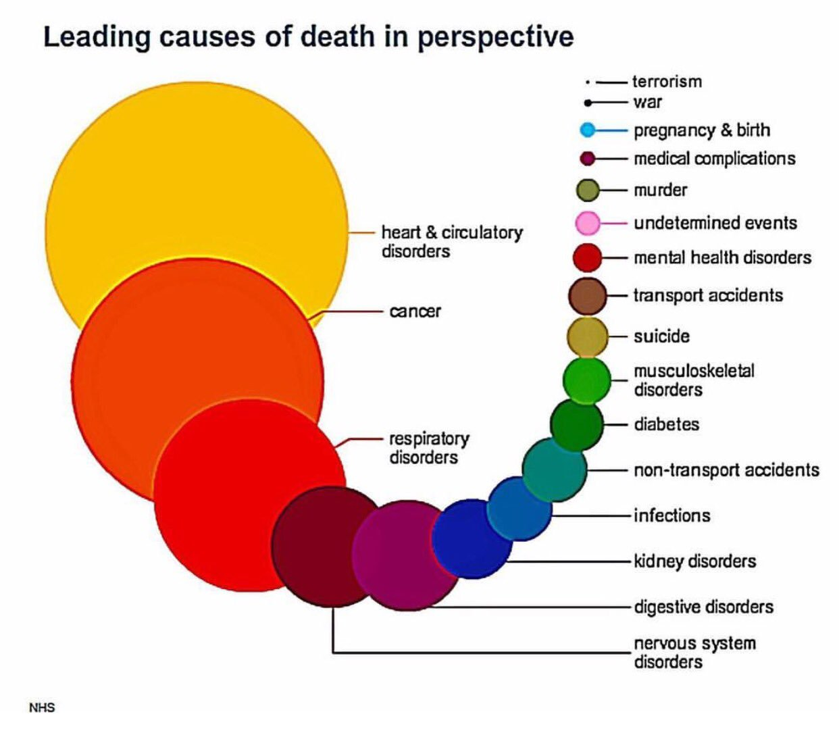

Slide 4
Notes:
ECG != PCG
Boli detectabiile prin PCG -> murmur si extrasistole

Slide 5
Problem description
Predict with a high rate of trust if a person has arrhythmia or murmurs through a phonocardiogram.
Data specifications
The .wav recordings have the following properties:
varying lengths, between 1 second and 30 seconds
44100 Hz and 4000 Hz samplerate
3 classes

Slide 6
Data processing
Normalization
Peak Analysis
Sliding window for data selection
Feature extraction

Slide 9
Feature extraction
Peak Frequency
Peak Frequency Standard Deviation
Peak Amplitude
Peak Amplitude Standard Deviation
Minimum Peak Distance
Maximum Peak Distance
Minimum Peak Amplitude
Maximum Peak Amplitude
Mean Amplitude
Standard Deviation Amplitude
Number of Peaks

Slide 10
Feature extraction

Slide 11
Classification Modeling
Multi-Class Convolutional Neural Network
Multi-Task Learning

Slide 12
Multi-Class CNN
Input layer: 16000
Hidden layer 1: 15991, 12
Hidden layer 2: 3198, 12 => 38376
Hidden layer 3: 500
Hidden layer 4: 100
Hidden layer 5: 20
Output layer: 3
Activation function: ReLU and Softmax
Loss function: Categorical crossentropy

Slide 13
CNN Normal heartbeat
Input layer: 16000
Hidden layer 1: 15991, 4
Hidden layer 2: 3198, 4 => 12792
Hidden layer 3: 500
Hidden layer 4: 100
Hidden layer 5: 20
Output layer: 2
Activation function: ReLU and Softmax
Loss function: Categorical crossentropy

Slide 14
CNN Murmur heartbeat
Input layer: 16000
Hidden layer 1: 15991, 4
Hidden layer 2: 3198, 4 => 12792
Hidden layer 3: 500
Hidden layer 4: 100
Hidden layer 5: 20
Output layer: 2
Activation function: ReLU and Softmax
Loss function: Categorical crossentropy

Slide 15
AdaBoost Extrastole heartbeat

Slide 16
Results

Slide 17




Technologies

Slide 18

Vă mulţumesc pentru atenţia dumneavoastră!

